Slide 1
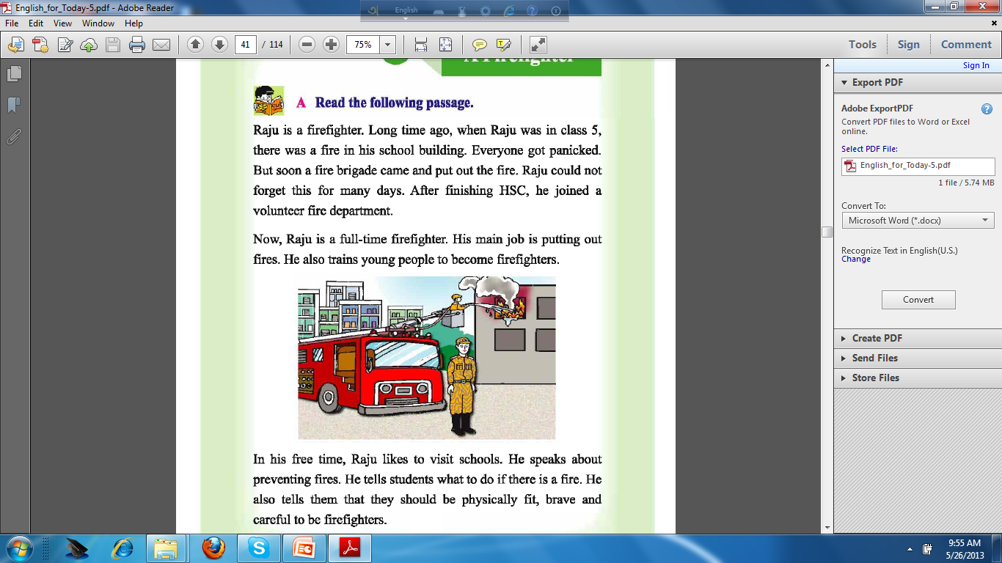

WELCOME

Slide 2


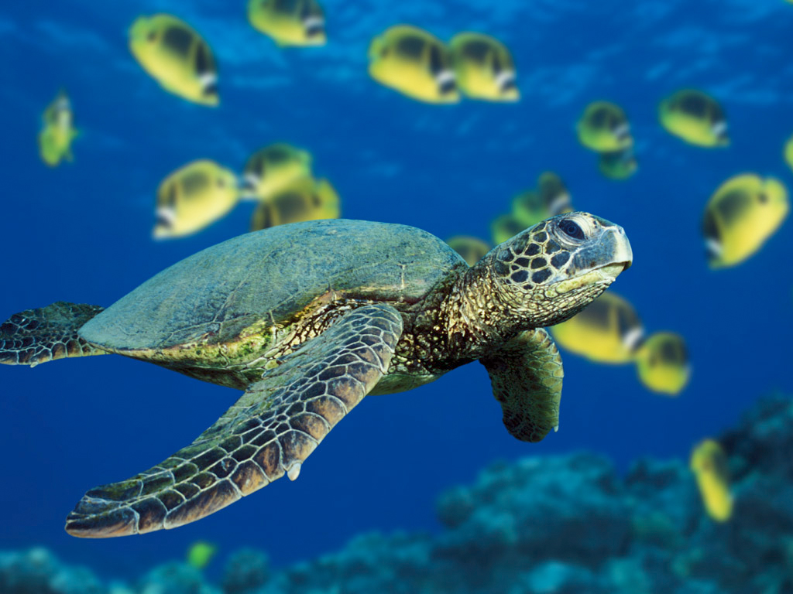
ENGLISH FOR TODAY
CLASS:V
TIME : 55 MINUTES

Slide 3
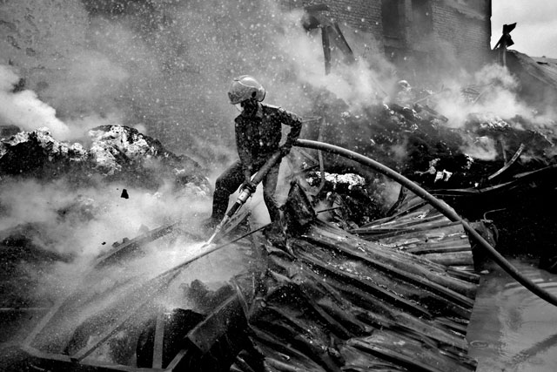
What can you see in the pictures ?
Video

Slide 4
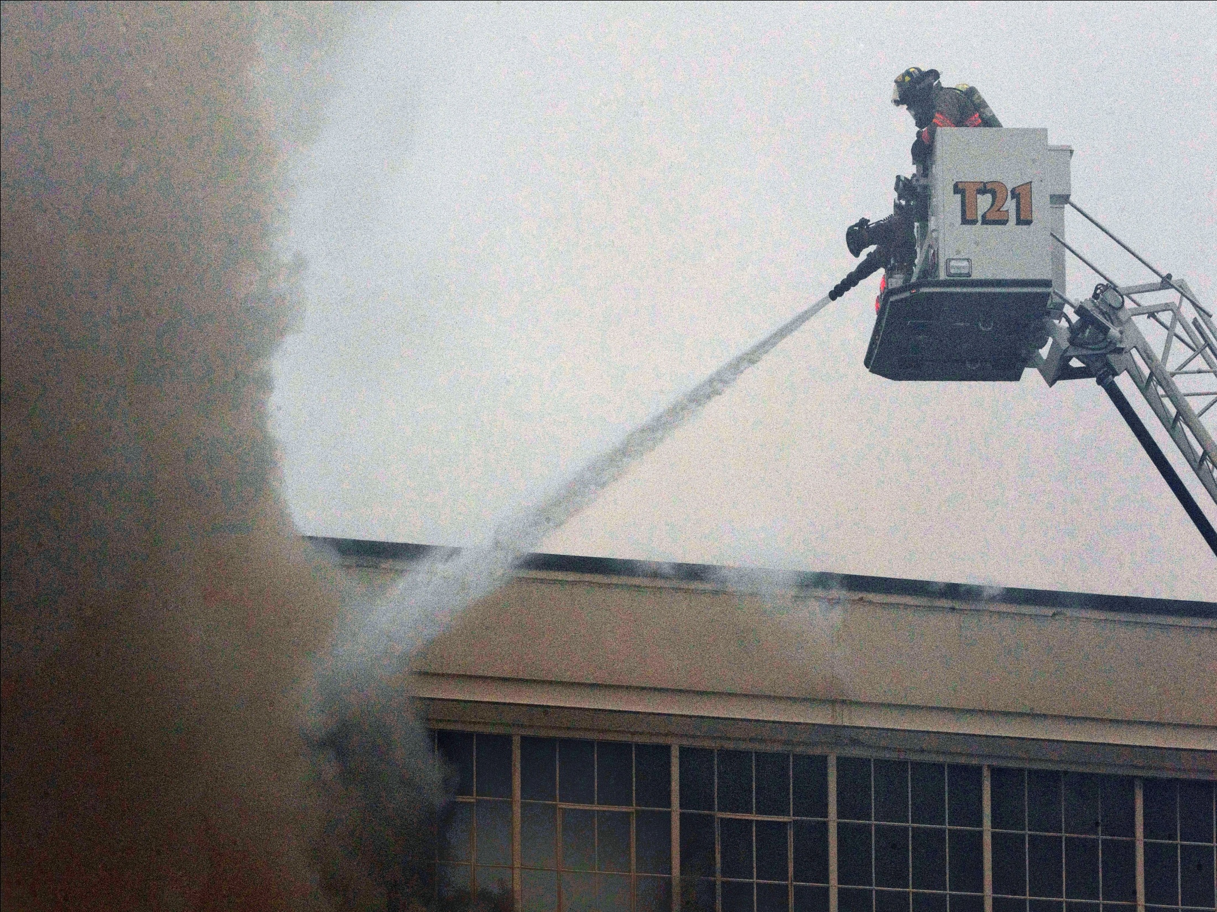

A FIREFIGHTER
Lesson 9
Page 36
Notes:
Declaration of Lesson

Slide 5
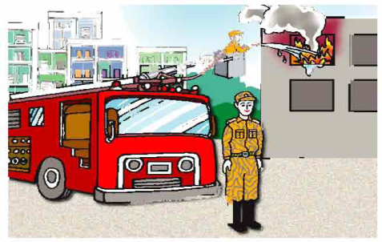
Learning Outcomes :
By the end of the lesson students will able to—
-- tell the meaning of the new words;
-- read an article on ‘A Firefighter’ with correct pronunciation.
-- write some statements using information given;
-- say true / false using sentences and structures given in the textbook.

Slide 6
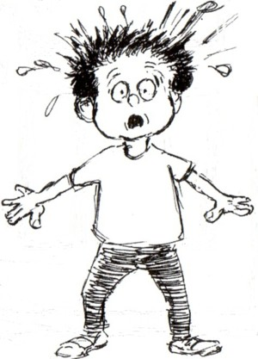
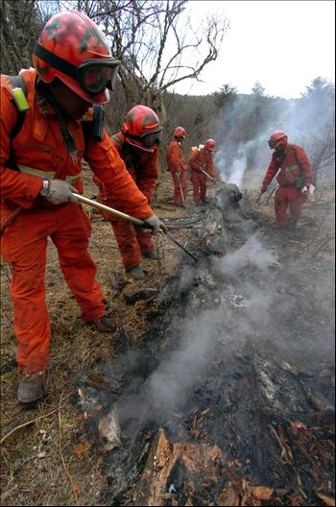
Vocabulary
Fearful
Panicked -
He got panicked to see the accident.
Mitigate
They put out the fire.
Put out -

Slide 7


Vocabulary
Check
Prevent -
Eat vegetable to prevent diseased.
Whole time
He works full-time in his office.
Full-time -

Slide 8

Open your book,listening the text you read aloud the topics from your textbook.

Slide 9
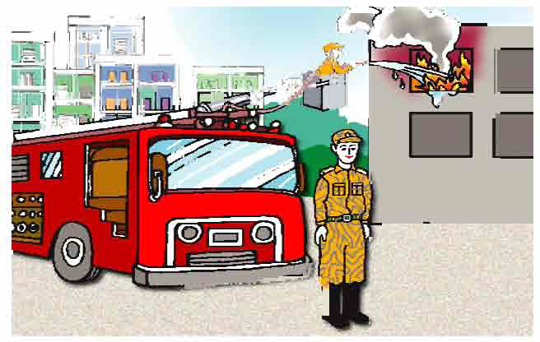
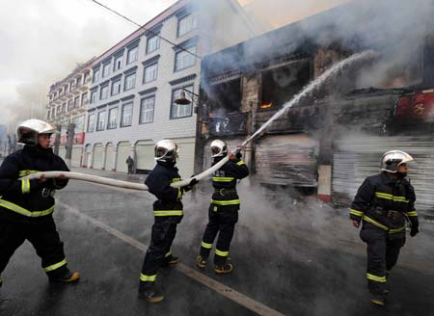
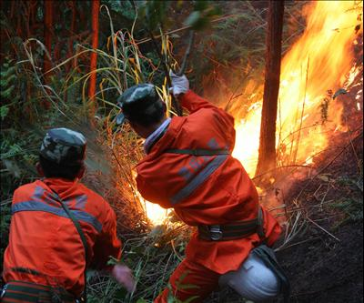
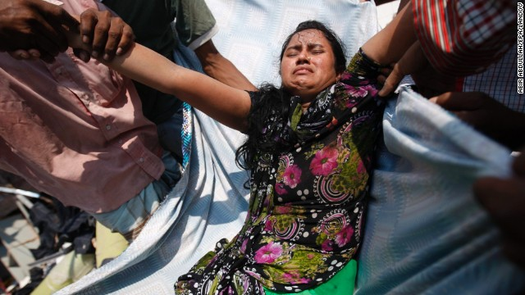
Now think! what does a firefighter do ?

Slide 10
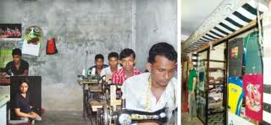
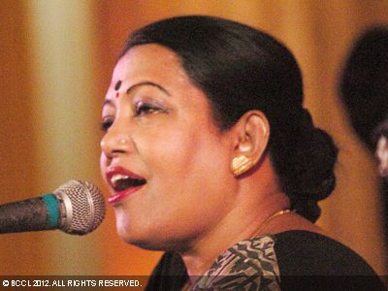
Fill in the gaps with a statement or a question as suitable.
1. What does a dressmaker do?
He makes dresses.
-------------------------------------------
2. What does a singer do?
She sings song.
-------------------------------------------

Slide 11
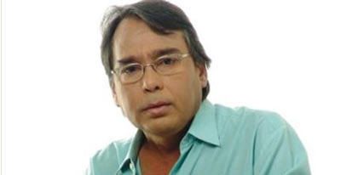
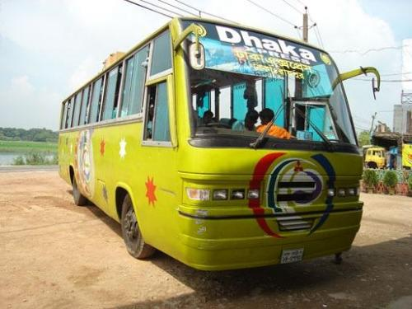
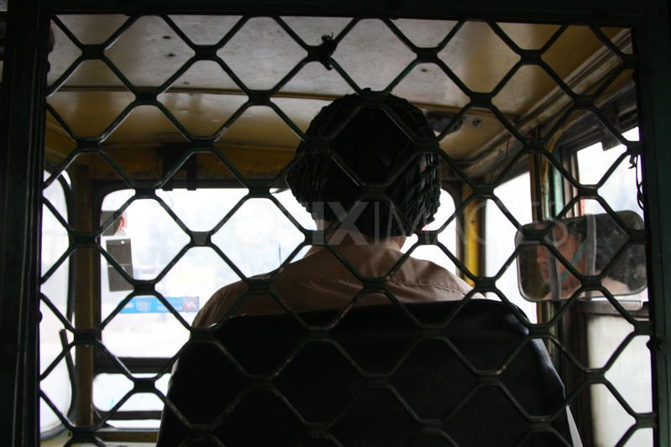
Fill in the gaps with a statement or a question as suitable.
1. What does a film actor do?
He acts in a cinema or a drama.
-------------------------------------------
2. What does a bus driver do?
He drives a bus.
-------------------------------------------

Slide 12
Group work
Write the name a few other professions that you know.

Slide 13
Evaluation
Say if the following statements are True or False. If false, give the true answer.
Raju is now a volunteer firefighter.
He’s afraid of fire, but it’s his job to fight fire.
A part of his job is to train people who want to become firefighters.
It’s his job to visit schools, too.
He tells children stories about his adventures.

Slide 14
False, Raju is a full-time firefighter.
Raju is now a volunteer firefighter.
He’s afraid of fire, but it’s his job to fight fire.
False, his main job is putting out fires.
True, he trains young people to become firefighters.
A part of his job is to train people who want to become firefighters.
False, In his free time, he likes to visit school.
It’s his job to visit schools, too.
He tells children stories about his adventures.
True, He tells students what to do if there is fire.

Slide 15
Homework / Assignment
Think of a person who works in your area to help you live well. Write a composition on this person by answering the following questions.
What does he / she do?
What time does he / she start his / her work?
How does he / she do the work?
Does he / she like the job? Why / why not?
What will happen if he / she stops working?
What do you think about his / her job?

Slide 16
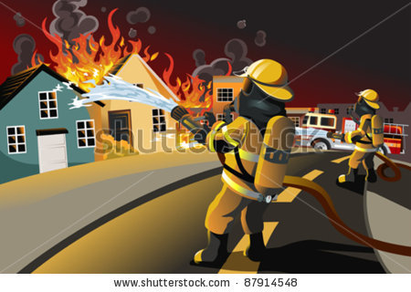
THANK YOU

Slide 17

Uttam Kumar Dasgupta
Instructor(General)
P T I Potiya, Chittagong,
Chittagong
ukdg_coxb@yahoo.com
01712181908

